Slide 1


Extracting Prerequisite Relations Among
Wikipedia Concepts Using the Clickstream Data
Cheng Hu¹, Kui Xiao^{1*}, Zesong Wang¹, Shihui Wang¹, Qifeng Li²
xiaokui@hubu.edu.cn(*Corresponding author)
1.School of Computer Science and Information Engineering
Hubei University, Wuhan, China
2 Academic Affairs Office of Hubei University, Wuhan, China

Slide 2
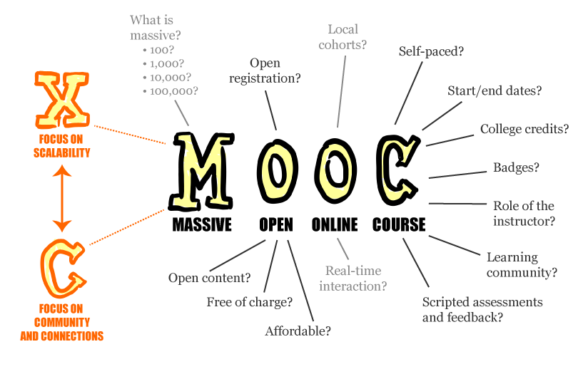
Introduction
For learning resource
In a textbook, each chapter contains some important knowledge concepts. Similarly, in a MOOC, each video lecture also introduces several main concepts.
There are no clear reading order list between the chapter or the video lecture.
There are usually some prerequisite relations between the concepts from different chapters or video lectures, which determine the order of the chapters in a textbook or the order of video lectures in a MOOC
……
For self-learners
When users browse the content of a Wikipedia article, they usually cannot
understand the content of the article due to lack of background knowledge.
If users know the prerequisite relations between articles, they will be able to quickly find out the articles in which the background knowledge is located
……

Slide 3
Related work
Wikipedia-based:
Use Hyperlinks, Edits and PageContent in Wikipedia
[1] Talukdar, P.P., Cohen, W.W.: Crowdsourced comprehension: predicting prerequisite structure in wikipedia. In: Proceedings of the Seventh
Workshop on Building Educational Applications Using NLP pp. 307–315. Association for Computational Linguistics, (2012).
Use a hyperlink-based method in Wikipedia
[2] Liang, C., Wu, Z.h., Huang, W.y., Giles, C.L.: Measuring prerequisite relations among concepts. In: Proceedings of the 2015 Conference on
Empirical Methods in Natural Language Processing pp. 1668–1674(2015).
Use link-based features, category-based features, content-based features, and time-based features in Wikipedia
[3] Zhou, Y., Xiao, K.: Extracting prerequisite relations among concepts in Wikipedia. In: 2019 International Joint Conference on Neural Networks
(IJCNN), pp. 1–8. IEEE (2019)
Wikipedia clickstream data-based:
Use features based on Wikipedia clickstream data
[4] Sayyadiharikandeh, M., Gordon, J., Ambite, J.L., Lerman, K.: Finding prerequisite relations using the Wikipedia clickstream. In: Companion
Proceedings of the 2019 World Wide Web Conference, pp. 1240–1247 (2019)

Slide 4
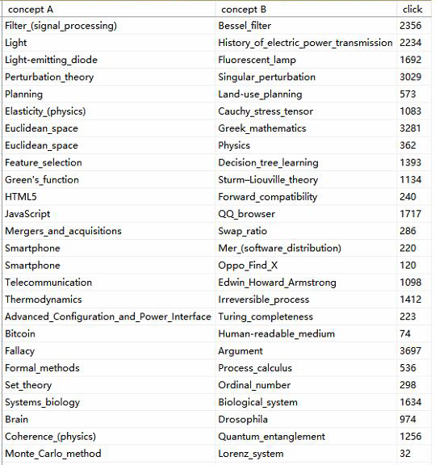
Wikipedia clickstream data
the first column Concept A as the source concept, the second column Concept B as the target concept, and the third column as the number of jumps from Concept A to Concept B by a Wikipedia user

Slide 5

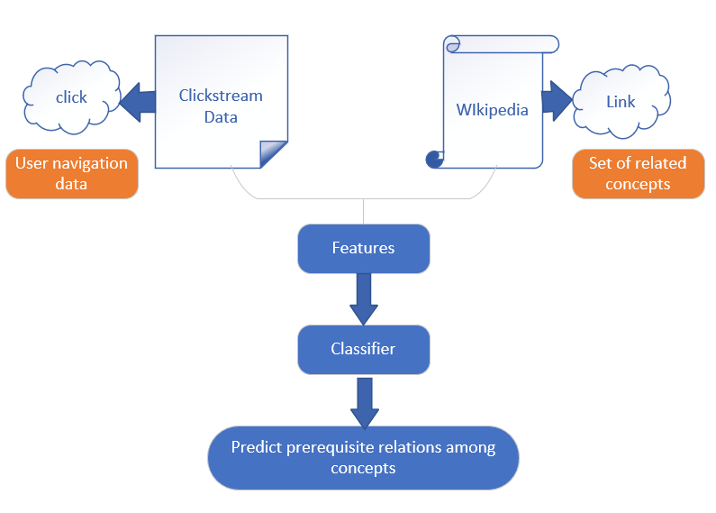
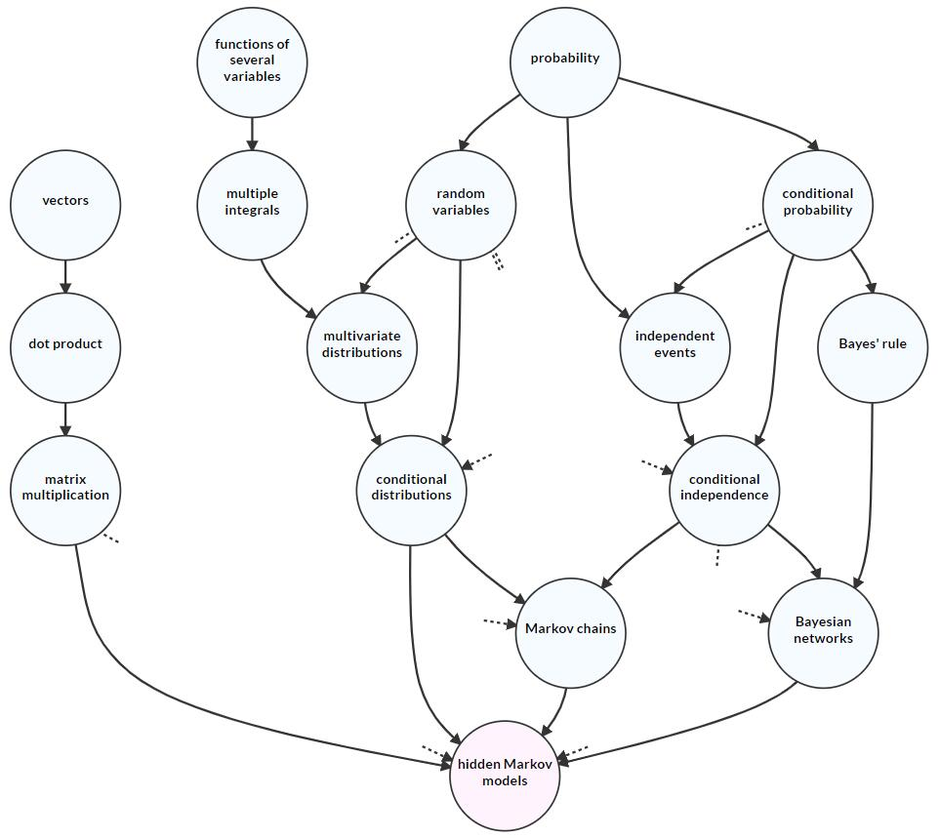

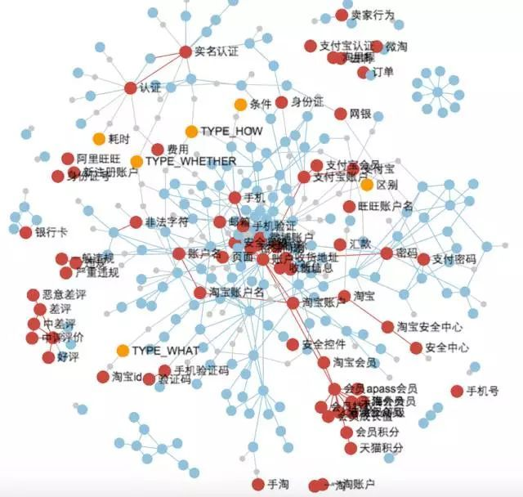
Methods
Personalized learning design
Extracting Prerequisite relations
Domain knowledge network
Course planning

Slide 6
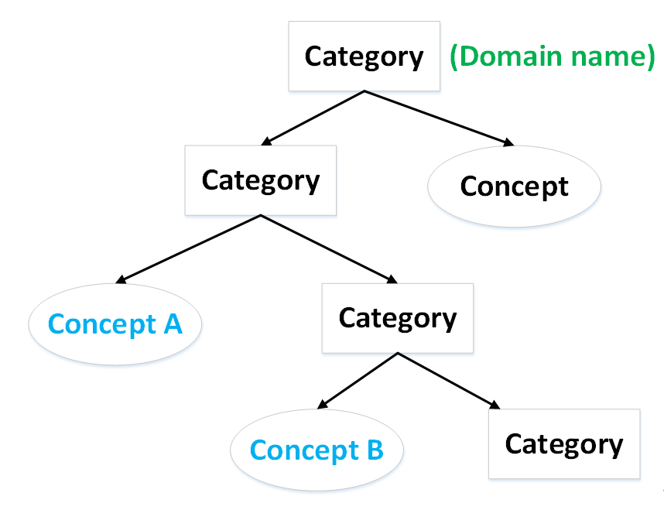
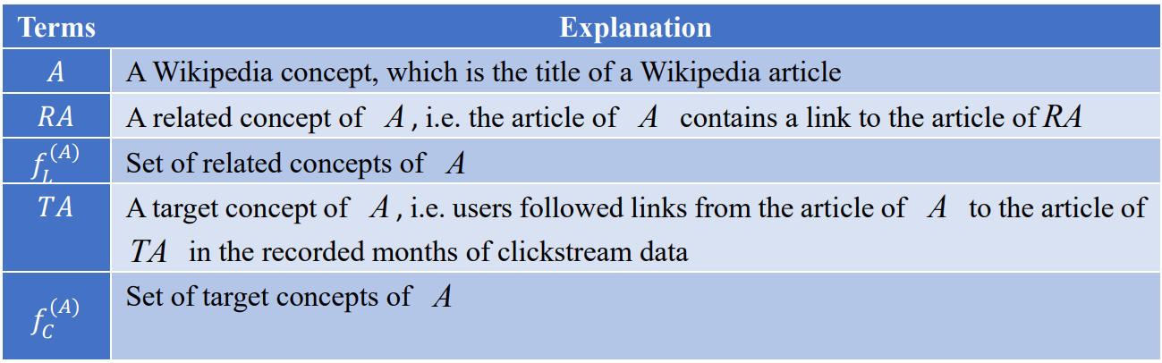
Methods

Slide 7
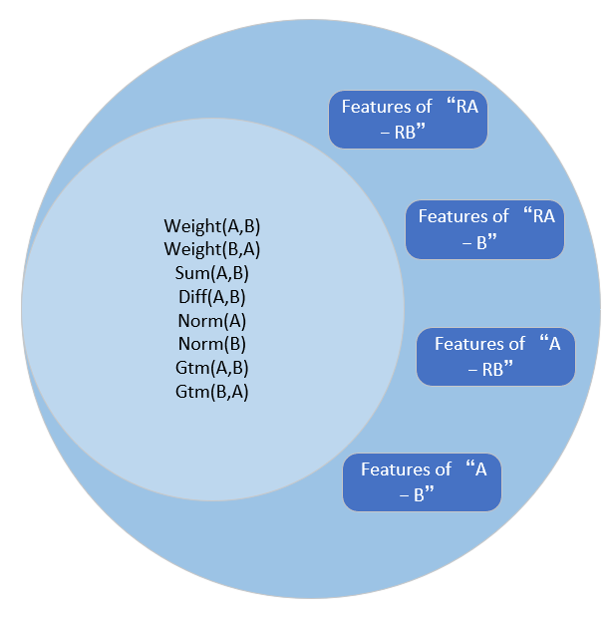
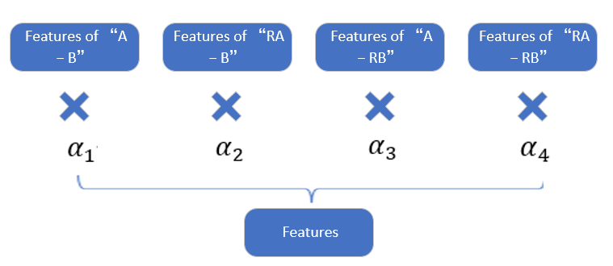
Methods

Slide 8
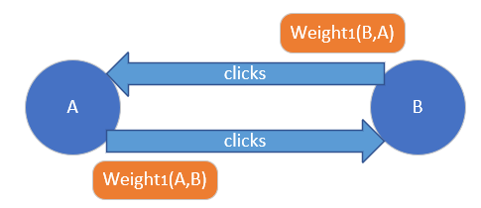
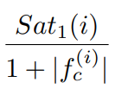
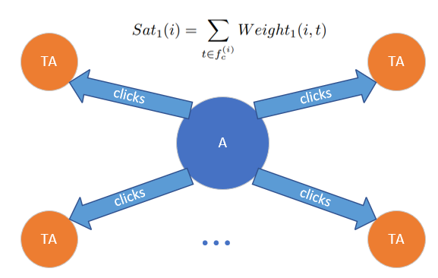
Features of “A-B”
Sum(A,B) = Weight1(A,B) + Weight1(B,A)
Diff(A,B) = |Weight1(A,B) – Weight1(B,A)|
Norm(A) = Weight1(A,B)/(1+Sat1(A))
Norm(B) = Weight1(B,A)/(1+Sat1(B))
Mean1(i) =
Gtm(A,B) =
Gtm(B,A) =
1,if Weight1(A,B) > Mean1(A)
0,else
1,if Weight1(B,A) > Mean1(B)
0,else

Slide 9
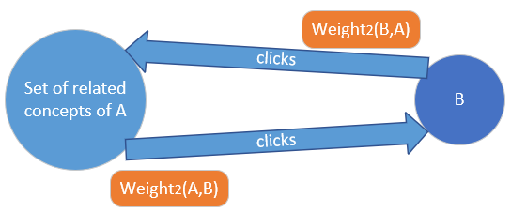
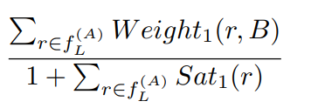
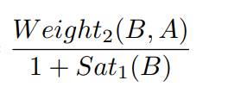
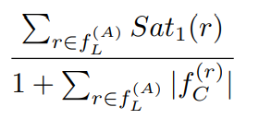
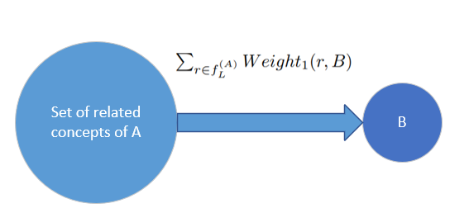
Features of “RA-B”
Sum(A,B) = Weight2(A,B) + Weight2(B,A)
Diff(A,B) = |Weight2(A,B) – Weight2(B,A)|
Norm(A) =
Norm(B) =
Mean2(i) =
Gtm(A,B)=
Gtm(B,A) =
1,if Weight2(A,B) > Mean2(A)
0,else
1,if Weight2(B,A) > Mean1(B)
0,else

Slide 10
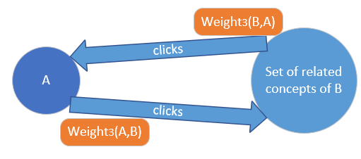

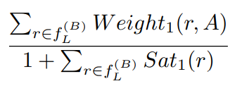
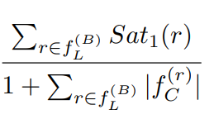
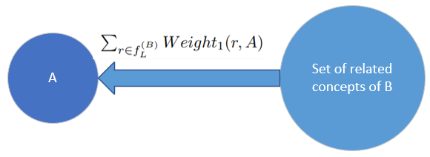
Features of “A-RB”
Sum(A,B) = Weight3(A,B) + Weight3(B,A)
Diff(A,B) = |Weight3(A,B) – Weight3(B,A)|
Norm(A) =
Norm(B) =
Mean3(i) =
Gtm(A,B) =
Gtm(B,A) =
1,if Weight3(A,B) > Mean1(A)
0,else
1,if Weight3(B,A) > Mean3(B)
0,else

Slide 11
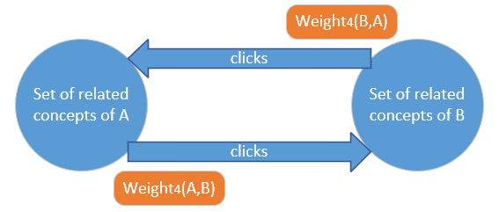
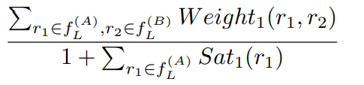
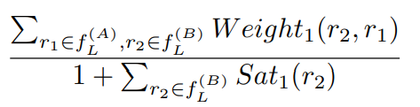
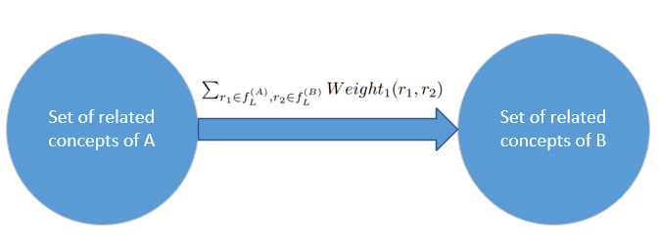
Features of “RA-RB”
Sum(A,B) = Weight4(A,B) + Weight4(B,A)
Diff(A,B) = |Weight4(A,B) – Weight4(B,A)|
Norm(A) =
Norm(B) =
Gtm(A,B) =
Gtm(B,A) =
1,if Weight4(A,B) > Mean2(A)
0,else
1,if Weight4(B,A) > Mean3(B)
0,else

Slide 12
Experiments-Datasets
CMU datasets^{[1]}
AL-CPL datasets^{[2]}
ID | Domain | # Total pairs | # A→B | # B→A | # Others
D₁ | _{Global Warming} | 400 | 82 | 68 | 250
D₂ | _{Meiosis} | 347 | 125 | 61 | 160
D₃ | _{Newton's Laws of Motion} | 400 | 116 | 61 | 223
D₄ | _{Parallel Postulate} | 200 | 41 | 27 | 132
D₅ | _{Public-key Cryptography} | 200 | 77 | 28 | 95
ID | Domain | # Total pairs | # Prerequisites
D₆ | _{Data Mining} | 826 | 292
D₇ | _{Geometry} | 1681 | 524
D₈ | _{Physics} | 1962 | 487
D₉ | _{Precalculus} | 2060 | 699
Talukdar, P. P. , & Cohen, W. W. . (2012). Crowdsourced Comprehension: Predicting Prerequisite Structure in Wikipedia. Workshop on Building Educational Applications Using Nlp. Association for Computational Linguistics.
Wang, S., Ororbia, A., Wu, Z., Williams, K., Liang, C., Pursel, B., & Giles, C. L. (2016, October). Using prerequisites to extract concept maps fromtextbooks. In Proceedings of the 25th acm international on conference on information and knowledge management (pp. 317-326).

Slide 13
Experiments-Concept pair coverage
the clickstream data in seven domains cover more than 90% of the concept pairs.Compared with not using related concepts, i.e. the fifth column, the coverage has been greatly improved.
On the AL-CPL dataset, however, the concept pair coverage based on related concept sets is slightly lower than the coverage based on one or two intermediate nodes. We suppose it is because the Wikipedia concepts in the AL-CPL dataset are selected from textbooks. Intermediate nodes strengthen the link between concepts, and increase the coverage of concept pairs.
Datasets | ID | Domains | #pairs | A-B(%) | A-M1-B(%) | A-M1-M2-B(%) | A-B/RA-B/A-RB/RA-RB(%)
AL-CPL | D1 | Data mining | 826 | 36.44 | 91.40 | 93.70 | 87.18
 | D2 | Geometry | 1681 | 25.46 | 93.46 | 94.11 | 93.63
 | D3 | Physics | 1962 | 29.61 | 98.01 | 98.57 | 95.01
 | D4 | Pre-calculus | 2060 | 29.17 | 97.28 | 97.82 | 96.02
 | Total |  | 6529 | 29.27 | 95.77 | 96.57 | 93.98

Slide 14
Experiments
Important parameters
5-fold cross validation
Different classification characteristic ML classifier
Scikit-learn 0.21.0
F1 (f1_weighted), P (precision_weighted) and R (recall_weighted)
Classifiers |  | CMU |  |  |  |  | AL-CPL
 |  | D1 | D2 | D3 | D4 | D5 | D6 | D7 | D8 | D9
RF | P | 75.9 | 91.2 | 77.3 | 89.3 | 71.8 | 66.0 | 72.8 | 78.6 | 76.1
 | R | 81.9 | 92.2 | 84.3 | 90.6 | 82.2 | 67.2 | 74.2 | 81.6 | 76.8
 | F1 | 78.5 | 91.7 | 80.5 | 89.8 | 76.6 | 65.4 | 72.8 | 78.8 | 76.4
NB | P | 41.7 | 74.2 | 80.2 | 79.5 | 77.3 | 46.8 | 63.8 | 70.6 | 64.6
 | R | 28.5 | 81.6 | 83.3 | 84.0 | 82.2 | 55.6 | 70.2 | 76.7 | 71.2
 | F1 | 20.8 | 77.0 | 81.0 | 80.8 | 79.1 | 46.2 | 63.0 | 72.1 | 63.5
C4.5 | P | 77.4 | 76.8 | 77.7 | 73.4 | 77.1 | 64.0 | 70.1 | 73.4 | 70.2
 | R | 74.8 | 75.3 | 77.8 | 71.1 | 75.1 | 61.9 | 70.4 | 73.4 | 69.8
 | F1 | 75.6 | 75.9 | 77.4 | 71.1 | 75.7 | 62.4 | 70.2 | 73.3 | 69.9
MLP | P | 74.6 | 74.6 | 79.1 | 75.5 | 78.8 | 64.3 | 62.5 | 71.1 | 64.0
 | R | 84.1 | 76.6 | 75.1 | 82.7 | 79.6 | 56.5 | 63.7 | 72.6 | 61.3
 | F1 | 78.9 | 74.3 | 76.3 | 78.6 | 78.7 | 57.7 | 60.2 | 70.5 | 60.7
SVM | P | 73.9 | 71.4 | 76.3 | 80.5 | 72.1 | 48.1 | 64.1 | 69.6 | 67.1
 | R | 85.8 | 84.5 | 86.4 | 87.2 | 84.8 | 68.9 | 71.1 | 79.5 | 71.8
 | F1 | 79.4 | 77.4 | 80.6 | 82.2 | 77.9 | 56.5 | 60.1 | 70.7 | 60.8
LR | P | 77.2 | 71.3 | 84.1 | 82.5 | 74.4 | 58.9 | 68.7 | 74.3 | 67.1
 | R | 85.5 | 83.2 | 87.0 | 87.2 | 84.2 | 68.0 | 71.7 | 79.1 | 72.0
 | F1 | 80.3 | 76.7 | 82.6 | 82.9 | 78.5 | 57.6 | 62.8 | 70.7 | 62.3
Ada | P | 78.6 | 77.5 | 76.6 | 80.0 | 72.9 | 69.0 | 73.4 | 76.6 | 74.1
 | R | 85.1 | 82.0 | 84.3 | 84.0 | 80.9 | 69.8 | 74.5 | 79.9 | 75.2
 | F1 | 80.1 | 78.6 | 79.9 | 81.5 | 76.6 | 66.2 | 73.5 | 75.6 | 74.2
In general,the random forest outperforms other classifiers. Consequently, we use RF in the following experiments

Slide 15
Experiments - Results
Methods | CMU |  |  |  |  | AL-CPL
 | D1 | D2 | D3 | D4 | D5 | D6 | D7 | D8 | D9
RefD-Equal | 57.4 | 53.0 | 63.7 | 70.5 | 55.2 | 70.1 | 57.1 | 68.4 | 72.7
RefD-Tfidf | 60.1 | 55.7 | 64.6 | 67.9 | 57.7 | 68.4 | 57.2 | 66.4 | 78.9
Direct link | 81.3 | 59.3 | 72.0 | 72.7 | 66.7 | 58.3 | 58.8 | 62.1 | 67.5
1 intermediate node | 78.0 | 75.4 | 84.2 | 70.0 | 72.7 | 68.9 | 75.8 | 72.4 | 76.3
2 intermediate nodes | 76.3 | 75.4 | 84.2 | 83.3 | 66.7 | 68.8 | 75.5 | 78.3 | 75.4
Proposed method | 91.8 | 92.2 | 89.7 | 90.6 | 83.3 | 69.4 | 76.4 | 81.6 | 76.8
our method outperforms all the baseline methods on seven of the nine domains

Slide 16
Experiments - Analysis
Features | Accuracy
Weight(A,B) | 74.5%(–2.3%)
Weight(B,A) | 73.7%(–3.1%)
Sum(A,B) | 74.5%(–2.3%)
Diff(A,B) | 73.3%(–3.5%)
Norm(A) | 73.2%(–3.6%)
Norm(B) | 69.5%(–7.3%)
Gtm(A,B) | 74.1%(–2.7%)
Gtm(B,A) | 73.8%(–3.0%)
The larger the proportion, the stronger the dependence of concept B on concept A. Therefore, after removing this feature, the overall concept prerequisite relations prediction accuracy drops the most

Slide 17
Conclusion
We used Wikipedia clickstream data and related concept sets to define concept pair features, and then inferred whether there was a prerequisite relation between two concepts. Experiments show that, the proportion of concept pairs covered by clickstream data has been significantly improved. And at the meanwhile, we can also accurately identify prerequisite relations.

Slide 18
Q & A
All the relevant code and data of the experiment have been released on github
Little-spider2001/Data-set-and-code-program-of-KSEM-2021-paper: 2021-2-paper (github.com)
Email: xiaokui@hubu.edu.cn Hucheng@stu.hubu.edu.cn

